Slide 1
Python 1.8 Analytics
Ms. Meade

Slide 2
Learning Intentions
2.18 - collect, store and sort both continuous and discrete data
3.4 - develop algorithms that can find the frequency, mean, median and mode of a data set
3.5 - structure and transform raw data to prepare it for analysis
3.6 - represent data to effectively communicate in a graphical form
3.7 - use algorithms to analyse and interpret data in a way that informs decision-making

Slide 3

Keywords
Data
.csv file
Comma Separated Values
.txt file
Text files
versatile
Persistence
Delimiters
split() function

Slide 4
Analytics 1 – Accessing Data
Write Code to read in, store and retrieve data from files stored on our machines

Slide 5
Accessing Data:
Python Lists
We will store our data read from a text or .csv file.
This will allow us to easily calculate
Min and Max values
Mean
Mode
Median
Frequency
Text Files (.txt)
Files that only contain plain text, with no formatting or images.
They are the most versatile as they allow for persistence i.e. data is stored after the program is finished

Slide 6
Accessing Data:
Python Lists
We will store our data read from a text or .csv file.
This will allow us to easily calculate
Min and Max values
Mean
Mode
Median
Frequency
Text Files (.txt)
Files that only contain plain text, with no formatting or images.
They are the most versatile as they allow for persistence i.e. data is stored after the program is finished

Slide 7
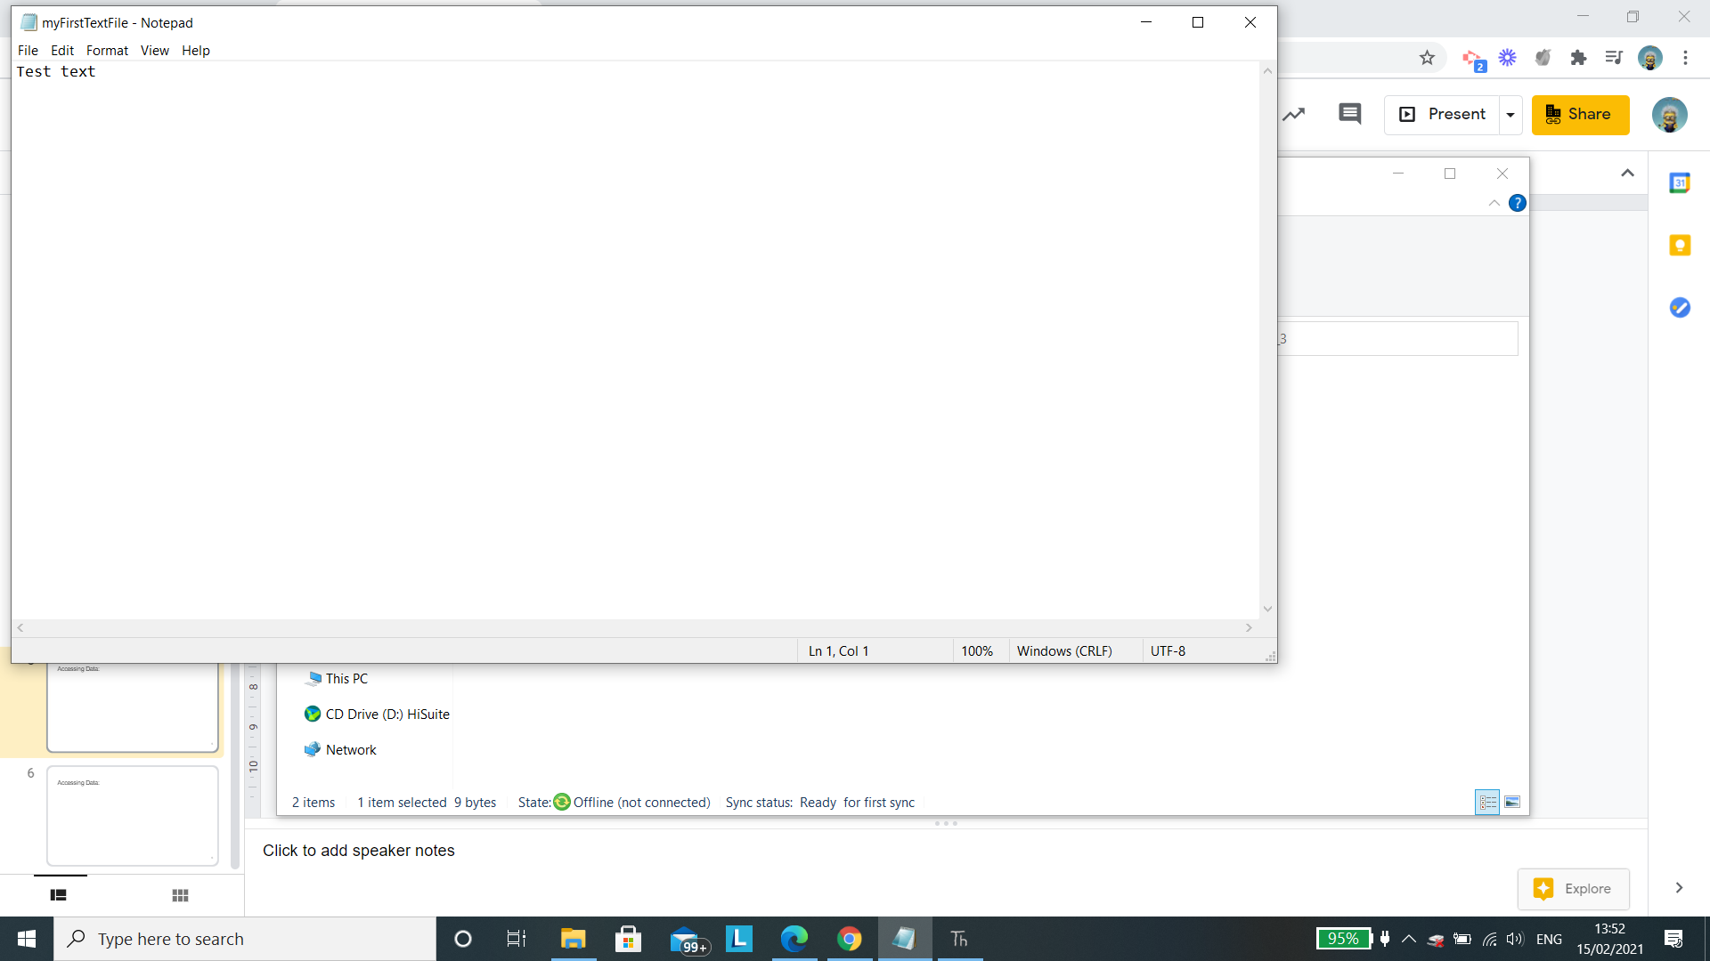
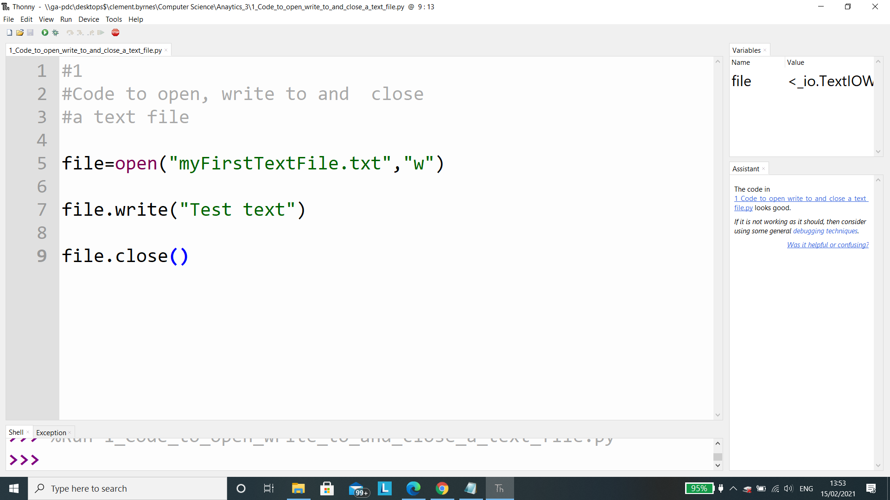
Accessing Data: Code to open, write to and close a text file
Output
This file is created in the same folder as the Python code is saved in
See next slide for explanation

Slide 8
Accessing Data: Code to open, write to and close a text file
The variable file is initialised
The open() function takes two arguments
First argument contains the file name myFirstTextFile.txt
The second argument refers to what we are doing with the file namely w - writes to the file (See Next slide)
Writes the string “Test text” to the file
Closes the connection to the file

Slide 9
Accessing Data: w, a and r
“w” - Writes data to a file (It overwrites any previous content in the file (Try replaceing “Test text” and run the code, What did you notice?)
“a” - append. The text is added to the end of what is currently in the file
“r” - read. The text is read from the file as a string.

Slide 10
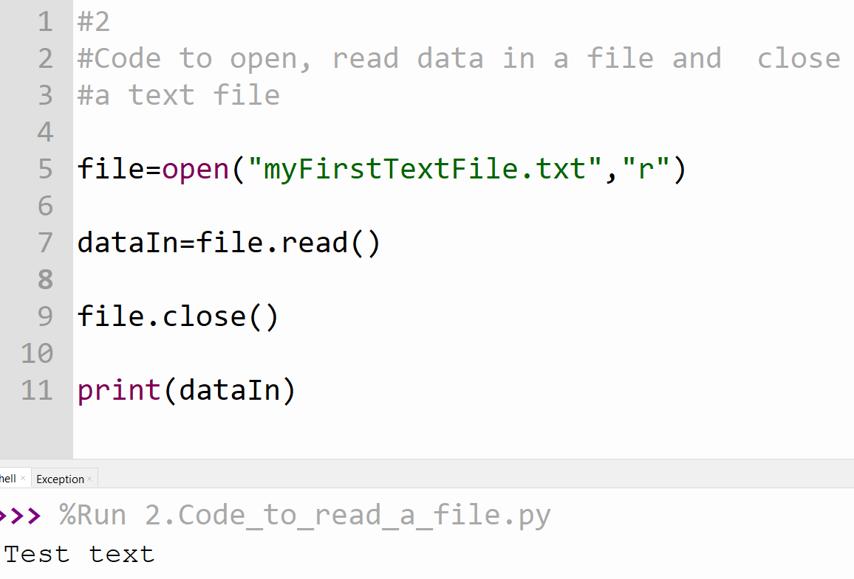
Accessing Data: To read the contents of a file
The variable file is initialised
The open() function takes two arguments
First argument contains the file name myFirstTextFile.txt
The second argument refers to what we are doing with the file namely r - to read the contents of the file.
The variable dataIn is initialised and stores the data read from the file
Prints the data stored in the variable dataIn

Slide 11

Accessing Data: CSV Files
CSV files (Comma Separated Values) used to store numerical data.
Uses commas to separate values making it easier for computer to read data
Unlike text files .csv files can be opened in Excel or Google sheets

Slide 12
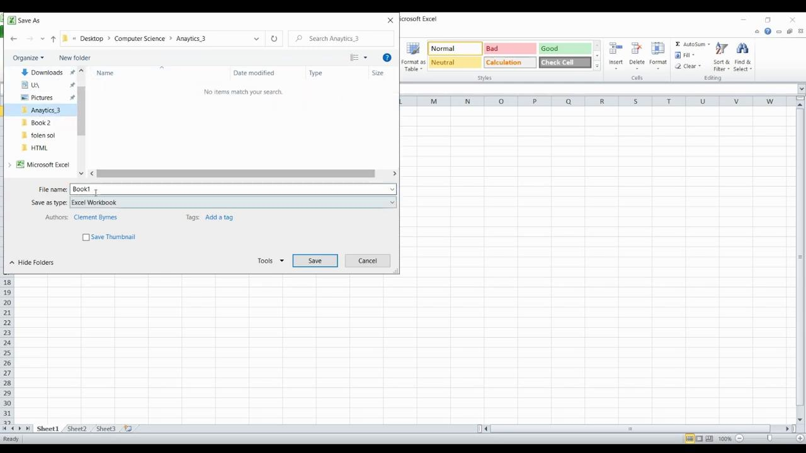
Accessing Data: Opening an excel sheet and saving as a .csv file

Slide 13
Accessing Data: Why .csv file are useful
Python can read and write them quickly
Excel can store a large number or rows, suitable for .csv file
Many applications can open and work with .csv files even you do not have Excel

Slide 14
Accessing Data: .csv file and Delimiters
A delimiter is the character used to separate values
In a.csv file this is the the comma

Slide 15
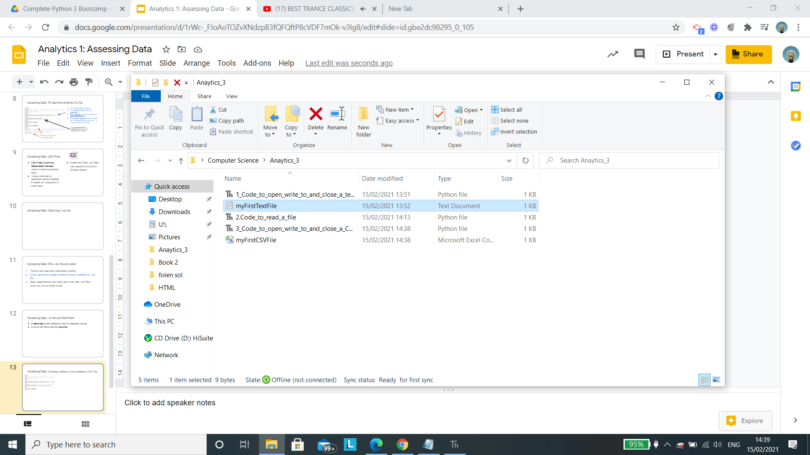
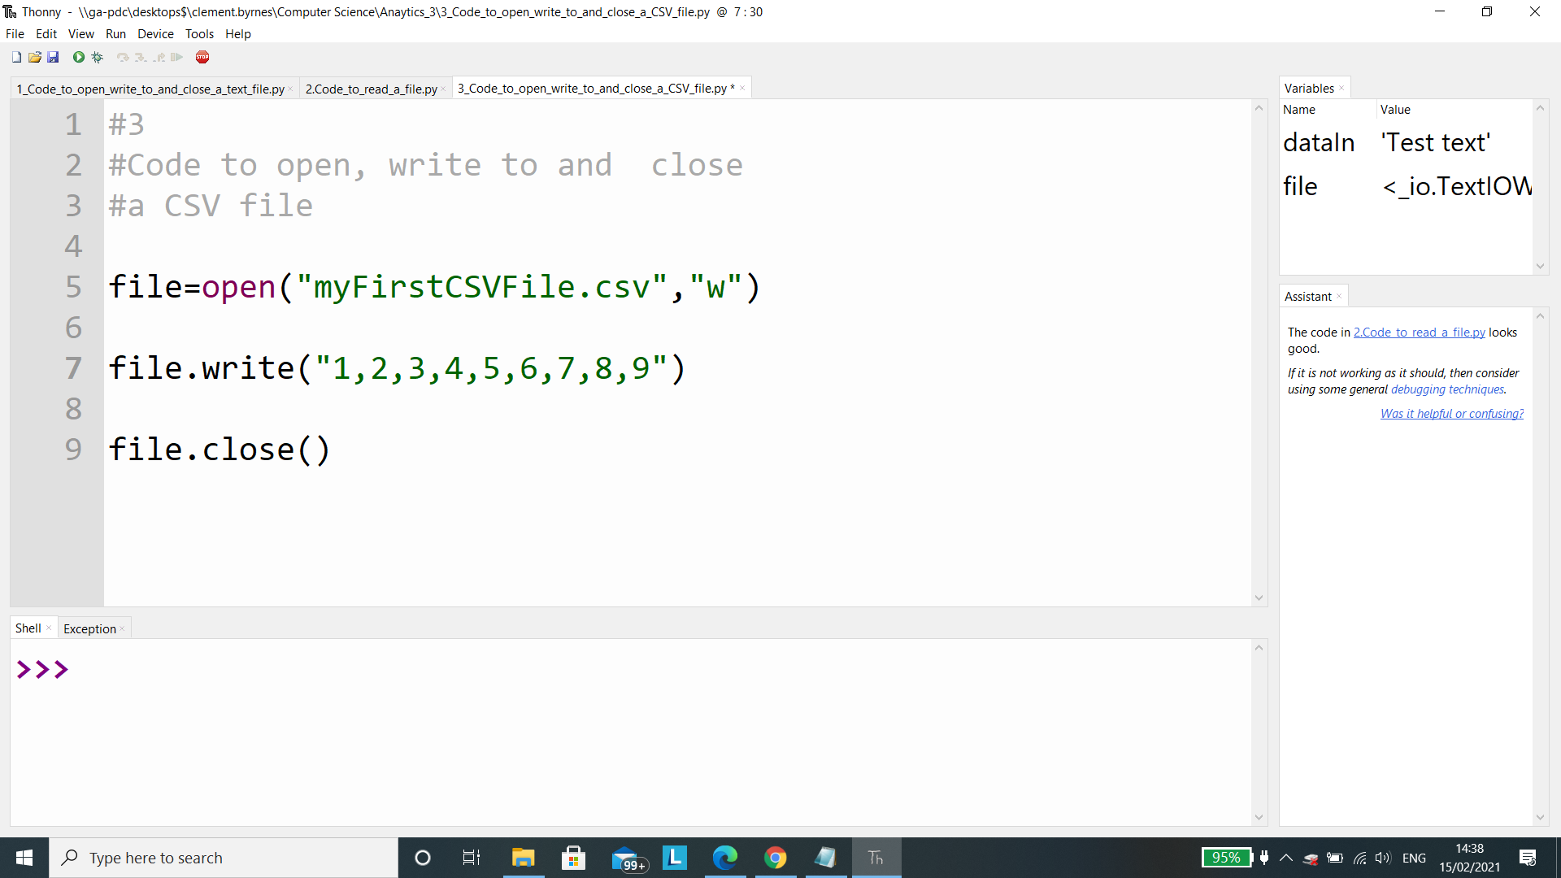
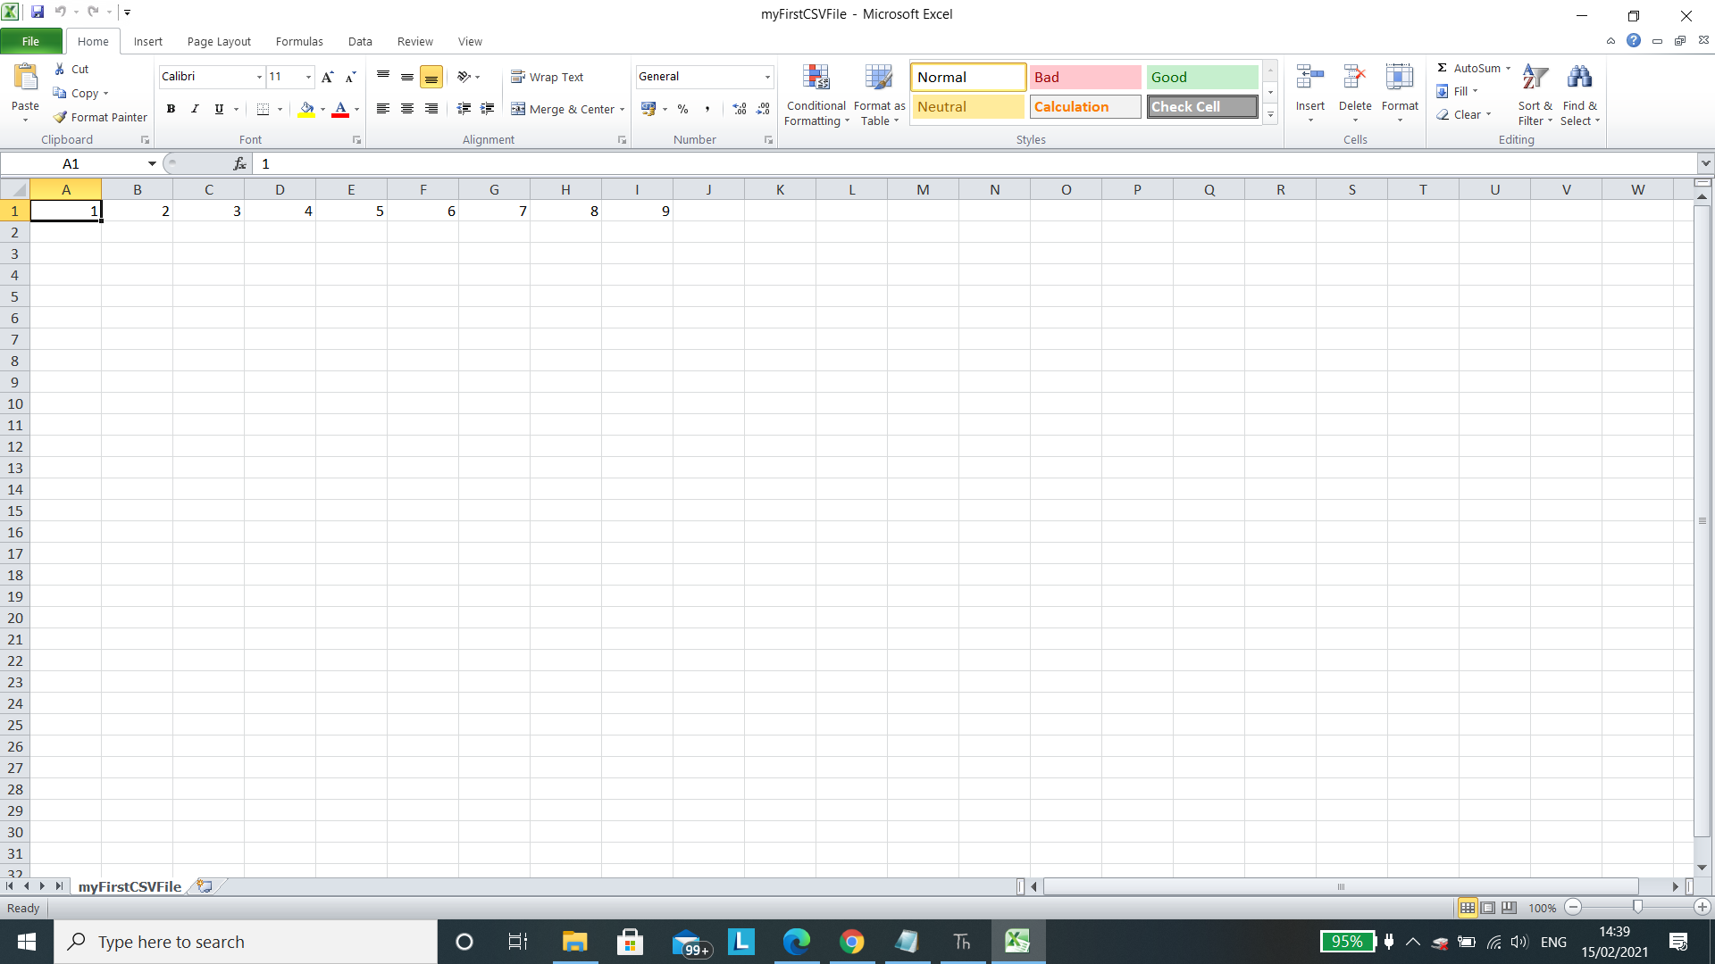
Accessing Data: Creating, writing to CSV file I
CSV created using Python

Slide 16
Accessing Data: Creating, writing to CSV file II
The variable file is initialised
The open() function takes two arguments
First argument contains the file name myFirstCSVFile.csv
The second argument refers to what we are doing with the file namely w - writes to the file
Writes the string “1,2,3,4,5,6,7,8,9” to the file
Closes the connection to the file

Slide 17
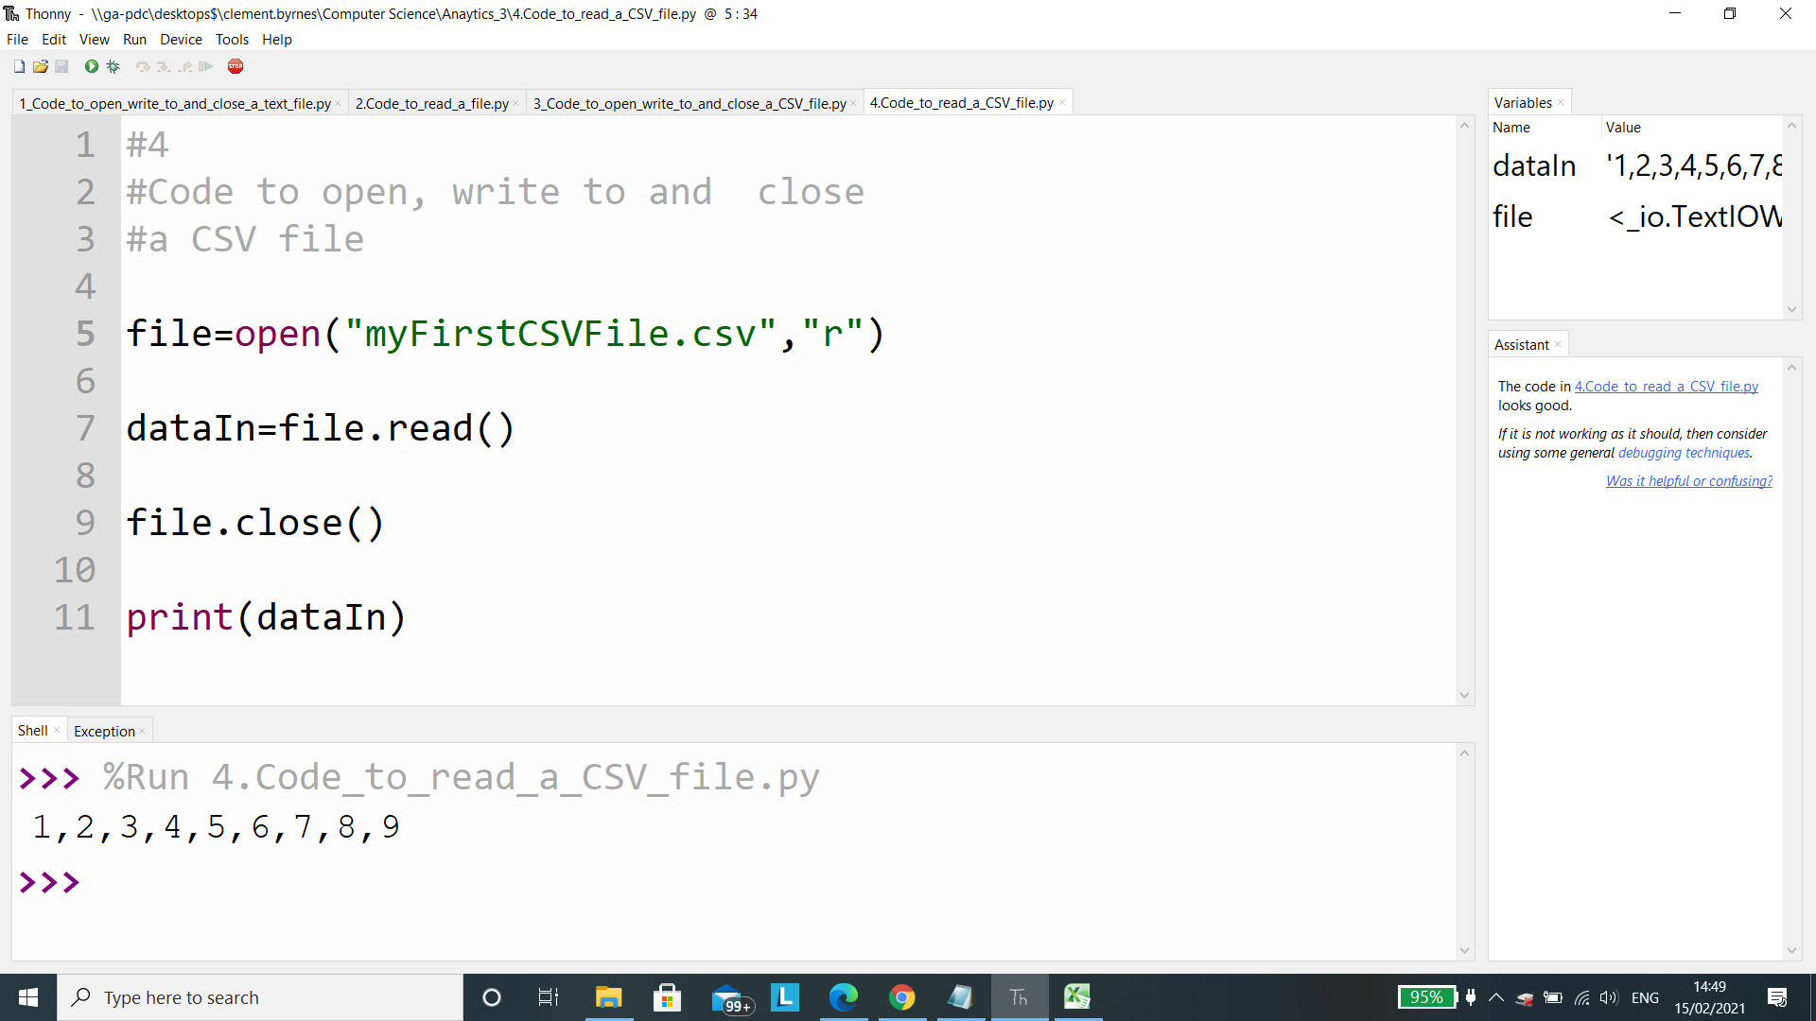
Accessing Data: To read the contents of a CSV file
The variable file is initialised
The open() function takes two arguments
First argument contains the file name myFirstCSVFile.csv
The second argument refers to what we are doing with the file namely r - to read the contents of the file.
The variable dataIn is initialised and stores the data read from the file
Prints the data stored in the variable dataIn

Slide 18

Accessing Data: csv Files and Lists I
The previous program displays a string. Strings cannot be used for numerical operations
Why?
The read() function reads all the ASCII characters, commas included in a single string.
How to extract the non-comma items we use the split() function.
Include this lines of code in the previous program and see what happens.
See next Slide

Slide 19
Accessing Data: csv Files and Lists II
The split() function creates a list called MyList which takes the delimiter “,” as an argument.
String
List

Slide 20
Accessing Data:
Is there another way?
Yes using loops to loop through each item using a list comprehension.
This allows us to convert the data to a list and then iterate through it and apply operators or functions to each item, one at a time, using just one line of code.

Slide 21
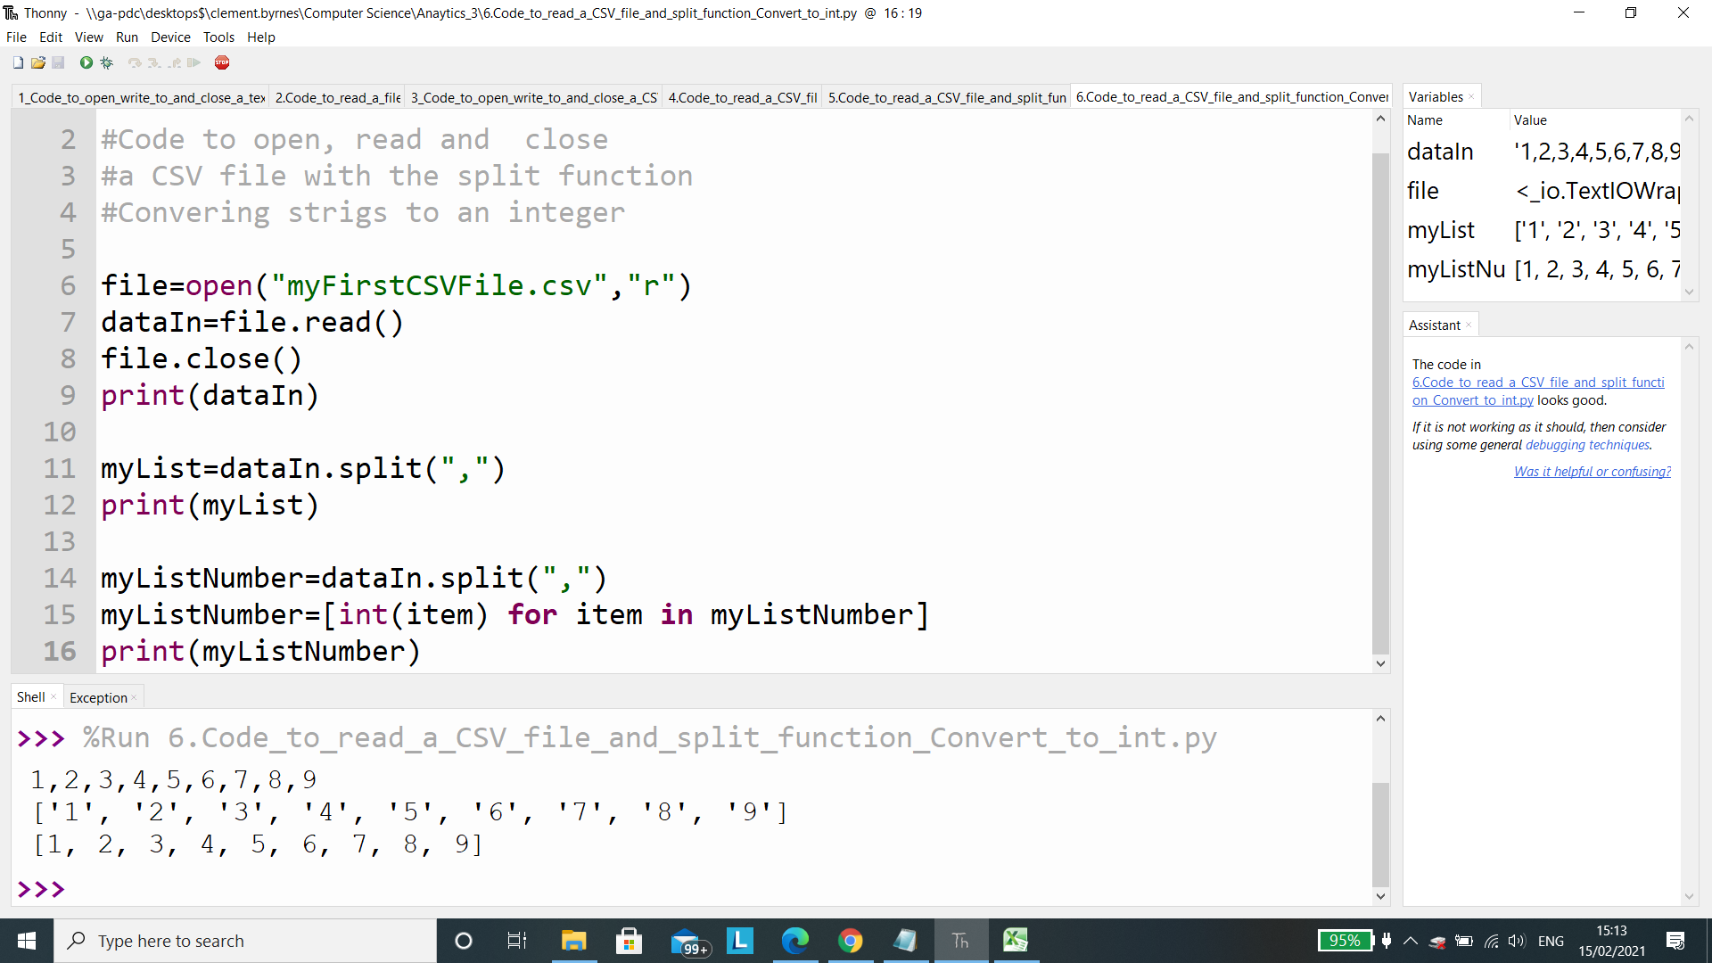
Accessing Data: csv Files and Lists and converting to ints
To do any numerical calculations we need to convert the data from a string datatype to an numerical datatype such as an integer.
Explanation on next slide

Slide 22
Accessing Data:
The list comprehension here :
Is a self contained for loop
It shows the square brackets to show it is returning a list.
The word item appears twice. This is a variable name and needs to be the same in both locations in the line of code.
In these 3 lines of code we have read a row of data from a CSV file, created a list using the split() function and then using a list comprehension, converted each item to an integer.

Slide 23
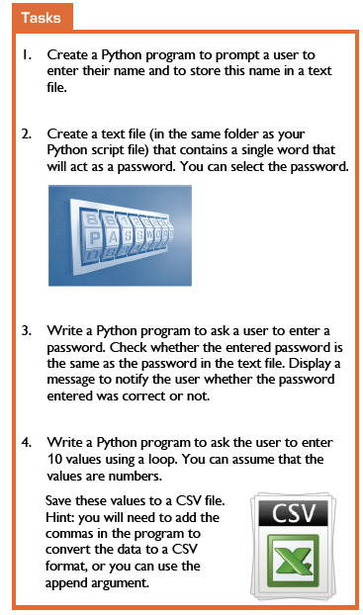
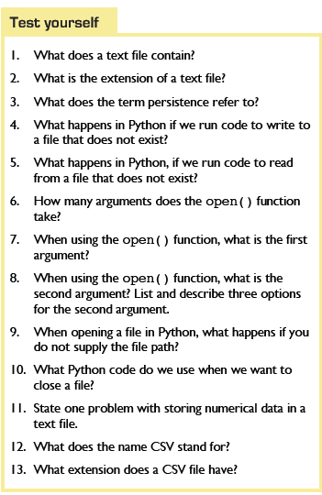
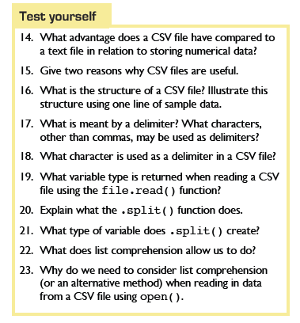
Accessing Data: Challenge
Complete Test yourself and the Tasks on Page 76-77
END

Slide 24
Analytics 2 – Pre-processing data

Slide 25
Learning intentions
2.18
collect, store and sort both continuous and discrete data
3.4
develop algorithms that can find the frequency, mean, median and mode of a data set
3.5
structure and transform raw data to prepare it for analysis
3.6
represent data to effectively communicate in a graphical form
3.7
use algorithms to analyse and interpret data in a way that informs decision-making

Slide 26
Keywords (Analytics 2: Pre-processing data)
Data
.csv file
Comma Separated Values
.txt file
Text files
versatile
Persistence
Delimiters
split() function
list
sort()
Ascending
Descending
Maximum value
Minimum value
remove()
Outlier
Imputation

Slide 27
Analytics 2: Pre-processing data
By pre-processing data we ensure that the data is of good quality.
Issues that may arise in data quality
Missing Data
Data that is out of range
Non validated data
A data structure that is incorrect
Reasons why these arise
Poor validation in the code that reads the data
Manual entry of data from paper
Typos

Slide 28
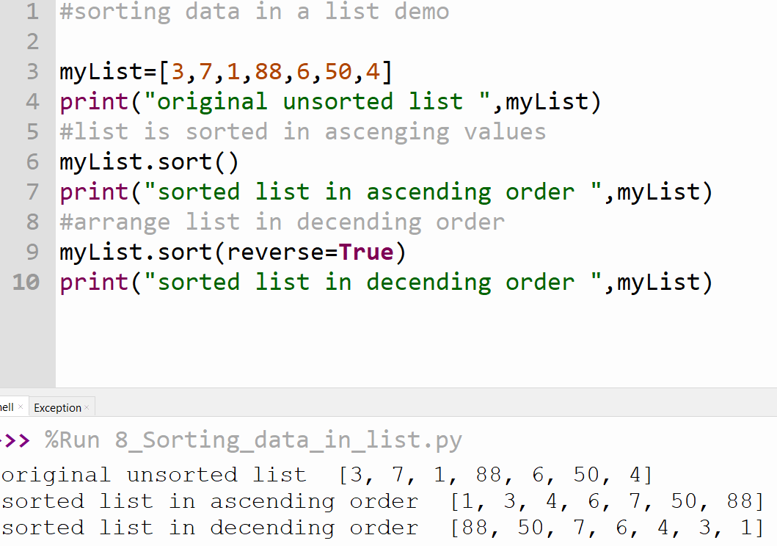
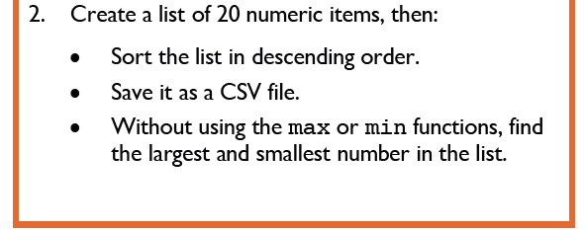
Analytics 2: Pre-processing data, Sorting
Sorting a list in ascending or descending order allows you to find the maximum and minimum value in a list.
Can you think of what code to write to print the max and min values?See Analytics 3
Try Q.2 Tasks p.79 (Use pseudocode to help solve the problems)

Slide 29
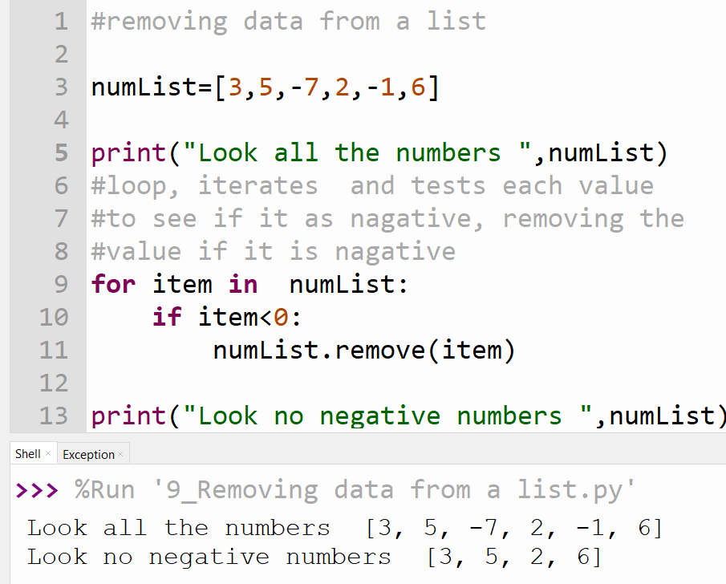
Analytics 2: Pre-processing data, Removing data
Sometimes it maybe necessary to remove an item from a list if it is an outlier using the remove() function.
e.g. if a negative number was entered due to a typo for the number of brothers or sisters per student in a class it will skew results such as the mean.
Pre-processing can remove these values.
In the next example the code removes the negative values from a list
Try Task 1 P.79 (Use pseudocode to help solve the problem)

Slide 30
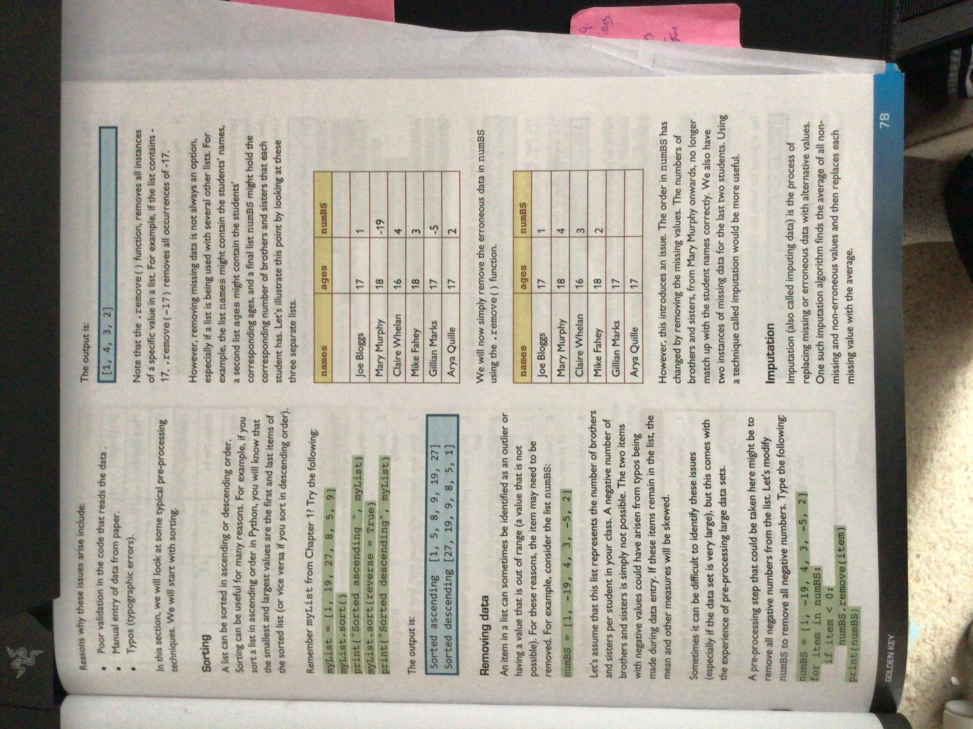
Analytics 2: Pre-processing data, Removing data WARNING
If working with several lists, removing data from one list may cause errors’
Removing the typos i.e. the negative values.
Can you notice any mismatches and absent data?
How could we correct this?

Slide 31
Analytics 3a
Analysis: Finding Max and Min Values

Slide 32
Analytics 3 (a) Max and min :
We can use statistical methods to study data and use them to help reach a conclusion/answer to a question. We use the following
Max and Min
Mean
Median
Frequency
Mode
We will show a number of ways of calculating each type.

Slide 33
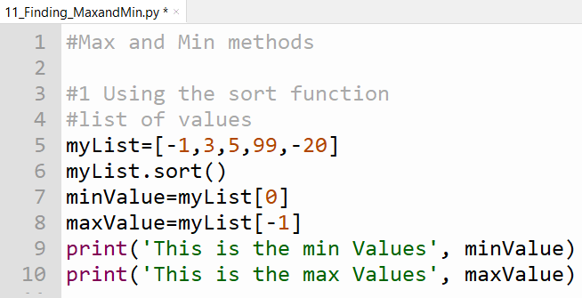
Analytics 3 (a) Max and min : Max and Min values 1 of 3 Using sort() function
Here we use the sort() function to order the items in a list in an ascending order.
This makes the first value in the list the minimum value
This makes the last item in the list the maximum value.
Type and run this code, change values in the list

Slide 34
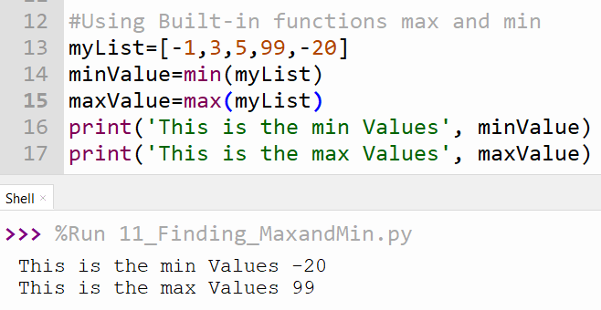
Analytics 3 (a) Max and min : Max and Min values 2 of 3:
Using Built-in functions max and min
Python has built-in functions to find the max and min value on a list

Slide 35
Analytics 3 (a) Max and min : Challenge
Write code to find the max and min of the following values
1,3,6,5,7,8,7,10
Create a .csv file that contains the following values
33,44,777,88,22
Write code will read the values and print the max and min of the values to the screen
END

Slide 36
Analytics 3b
Analysis: Finding the Mean

Slide 37
Computational Thinking _ before you go to the next slide
Create an Algorithm to find the mean of the values 2,4,6,7,8,9

Slide 38
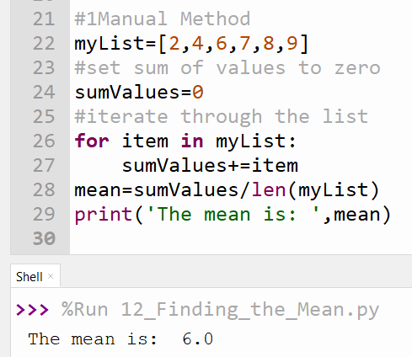
Analytics 3 (b) The Mean1 of 3, Manually calculating the mean
Add up all the values in the list
Divide this sum by total number of items in the list=Mean

Slide 39
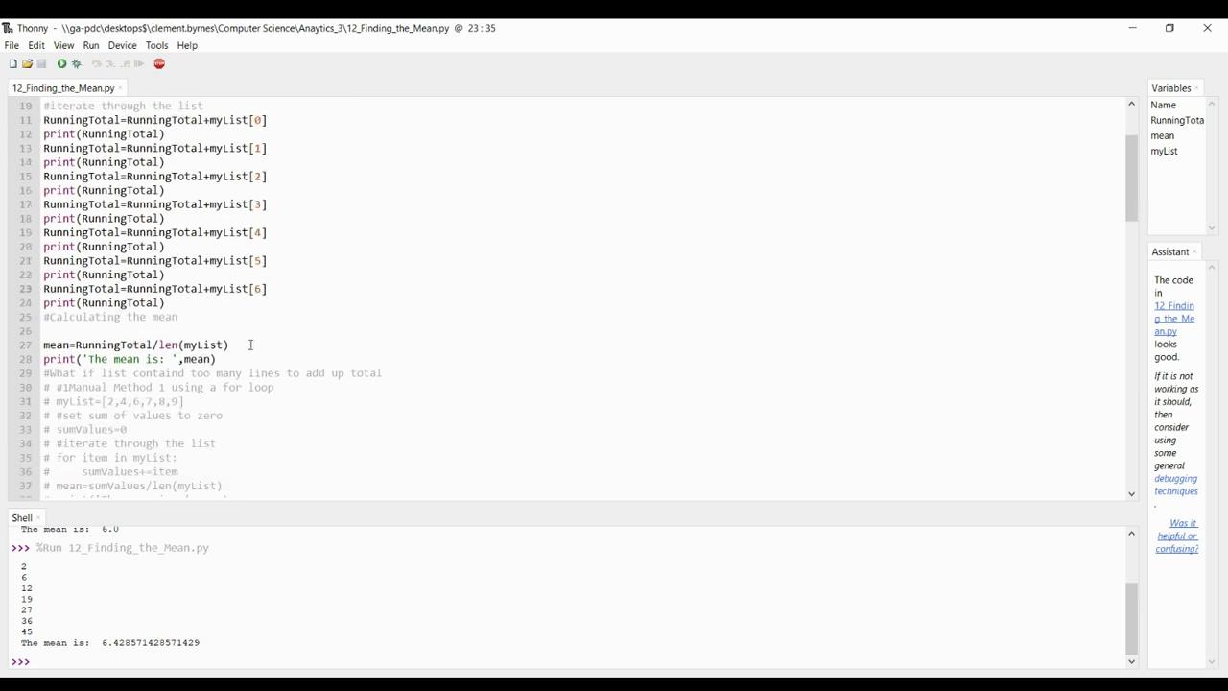

Analytics 3 (b) The Mean 1 of 3, Manually calculating the mean Videos
Running Total method Using a for loop(Click here to see explanation of code)

Slide 40
Analytics 3 (b) The Mean1 of 3, Manually calculating the mean, Some questions
How we know the program is working? (i.e. actual result vs. expected result)
Change the values in the list and see what happens?
What happens if there were more (or less) than 6 values in the list?
Change the variable names as see what happens
Does this program work for a list of strings (e.g. ["Mary", "Andy", "Pat"])? Why/why not?

Slide 41
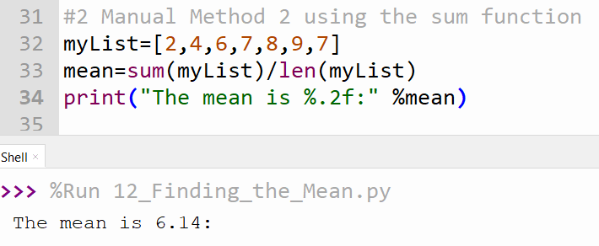
Analytics 3 (b) The Mean 2 of 3, Using the sum() function
The sum() function allows us to add up the contents of a list.
When we divide the sum of the items by the number of items i.e. the length of the list we get the mean of the numbers

Slide 42
Analytics 3 (b) The Mean 2 of 3, Using the sum() function, Some questions
How we know the program is working? (i.e. actual result vs. expected result)
Change the values in the list and see what happens?
What happens if there were more (or less) than 6 values in the list?
Change the variable names as see what happens
Does this program work for a list of strings (e.g. ["Mary", "Andy", "Pat"])? Why/why not?

Slide 43
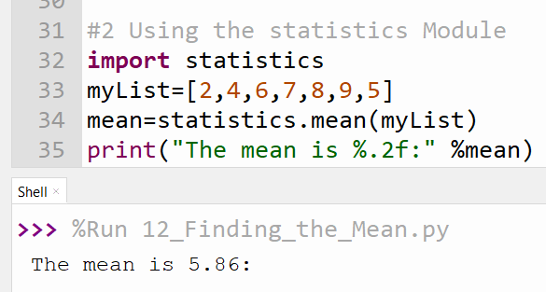
Analytics 3 (b) The Mean 3 of 3, Using the statistics Module
Importing the statistics module allows us to use a built in function the calculate the mean i.e.
statistics.mean()

Slide 44
Analytics 3 (b) The Mean 3 of 3, Using the statistics Module
, Some questions
How we know the program is working? (i.e. actual result vs. expected result)
Change the values in the list and see what happens?
What happens if there were more (or less) than 6 values in the list?
Change the variable names as see what happens
Does this program work for a list of strings (e.g. ["Mary", "Andy", "Pat"])? Why/why not?

Slide 45

Analytics 3 (b) The Mean: Challenge
Write code to find the mean of the following values
1,3,6,5,7,8,7,10
Write an app to calculate the mean of numbers entered by a user and and print the mean of the values to the screen to 2 decimal places.
Create a .csv file that contains the following values
1,3,6,5,7,8,7,10
Write code will read the values and print the mean of the values to the screen to 2 decimal places

Slide 46
Analytics 3c
Analysis: Finding the Median

Slide 47
What is the median? The median refers to the middle value
.Case 1: Odd Number of Items
myOddList=[1,2,3,4,5,6,7]
Here we have 7 items so 4 is the median
Case 2: Even Number of items
myEvenList=[1,2,3,4,5,6]
Here we have 6 items. We find the two middle items and their mean.
The median =(3+4/2)=3.5
We need to sort any list to find the median

Slide 48
Computational Thinking_ before you go to the next slide
Create an Algorithm to find the median of the values 1,2,5,4,3,6 and 1,4,3,2,5,7,6.
Sort list in ascending order
Determine if there are an even number or odd number of items in the list
Find the middle term if an odd number of items OR find the mean of the two middle terms if there is an even number of items in the list

Slide 49
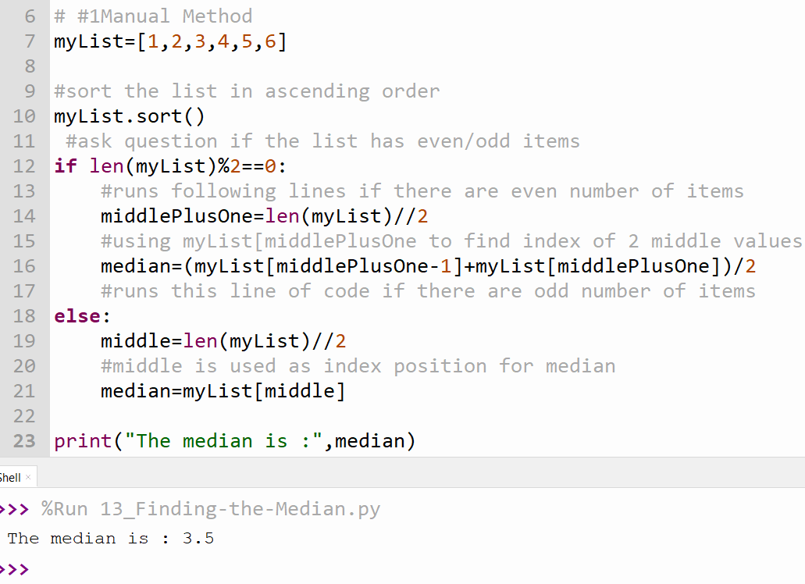
Analytics 3 (c): The Median 1 of 2, Manually calculating the median
Sort List
Check if list has an odd or even number of items
Evaluate the median based on step 2
Print median

Slide 50
Analytics 3 (c) The Median 1 of 2, Manually calculating the median, Some questions
How we know the program is working? (i.e. actual result vs. expected result)
Change the values in the list and see what happens?
What happens if there were more (or less) than 6 values in the list?
Change the variable names as see what happens
Does this program work for a list of strings (e.g. ["Mary", "Andy", "Pat"])? Why/why not?

Slide 51
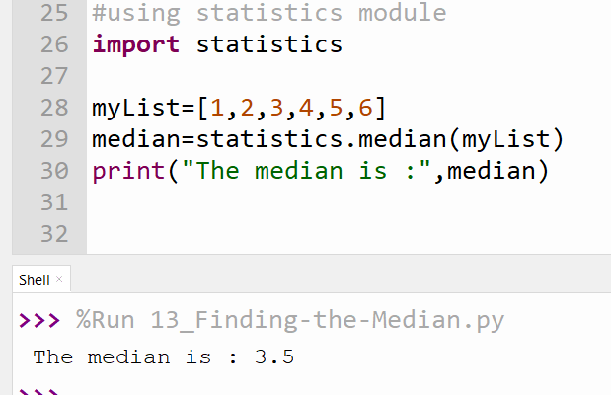
Analytics 3 (c): The Median 2 of 2, Using statistics module
Import statistics library
Calculate the median.

Slide 52
Analytics 3 (c) :The Median: Challenge
Write code to find the median of the following values
1,3,6,5,7,8,7,10
Write an app to calculate the median of numbers entered by a user and and print the median of the values to the screen
Create a .csv file that contains the following values
33,44,777,88,22
Write code will read the values and print the median of the values to the screen.

Slide 53
Analytics 3d
Analysis: Finding the Mode/Frequency

Slide 54
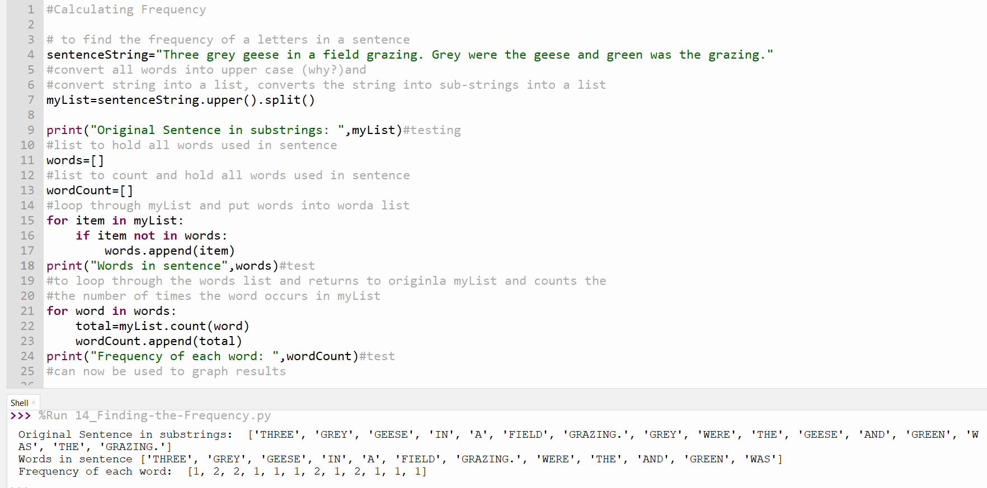
Measuring Frequency.
List words in sentence and place in word list.
Counts words in sentence and stores in wordCount list
We will build on this to calculate the mode manually.

Slide 55
Video on code to find frequency of an item

Slide 56
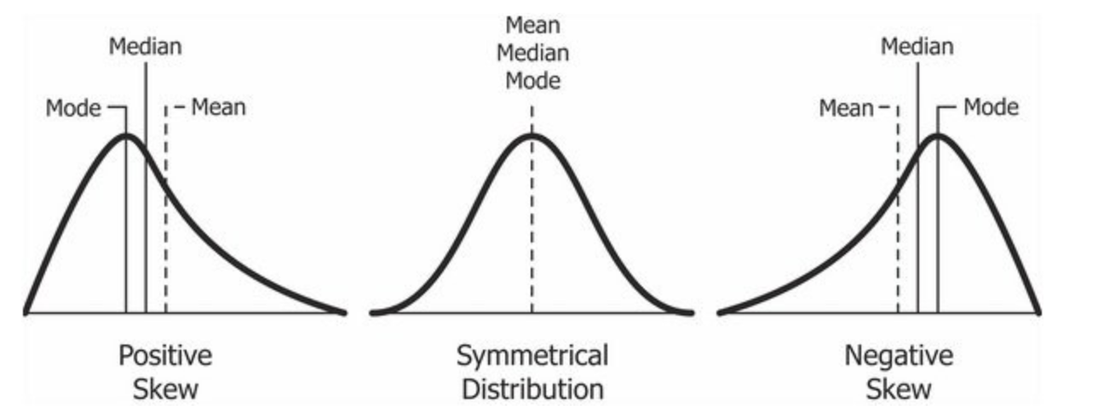
What is the Mode?
The mode refers to the value that occurs the most often in a data set.

Slide 57
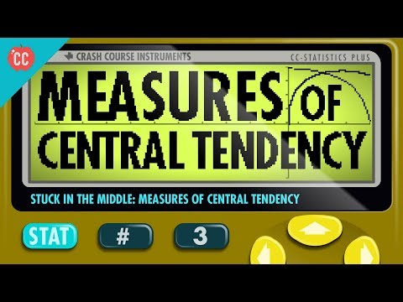
What can the mode, mean and median tell us?

Slide 58
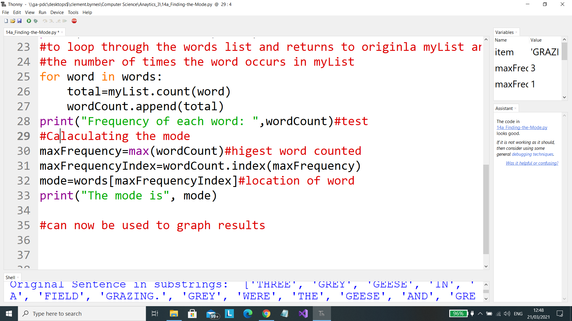
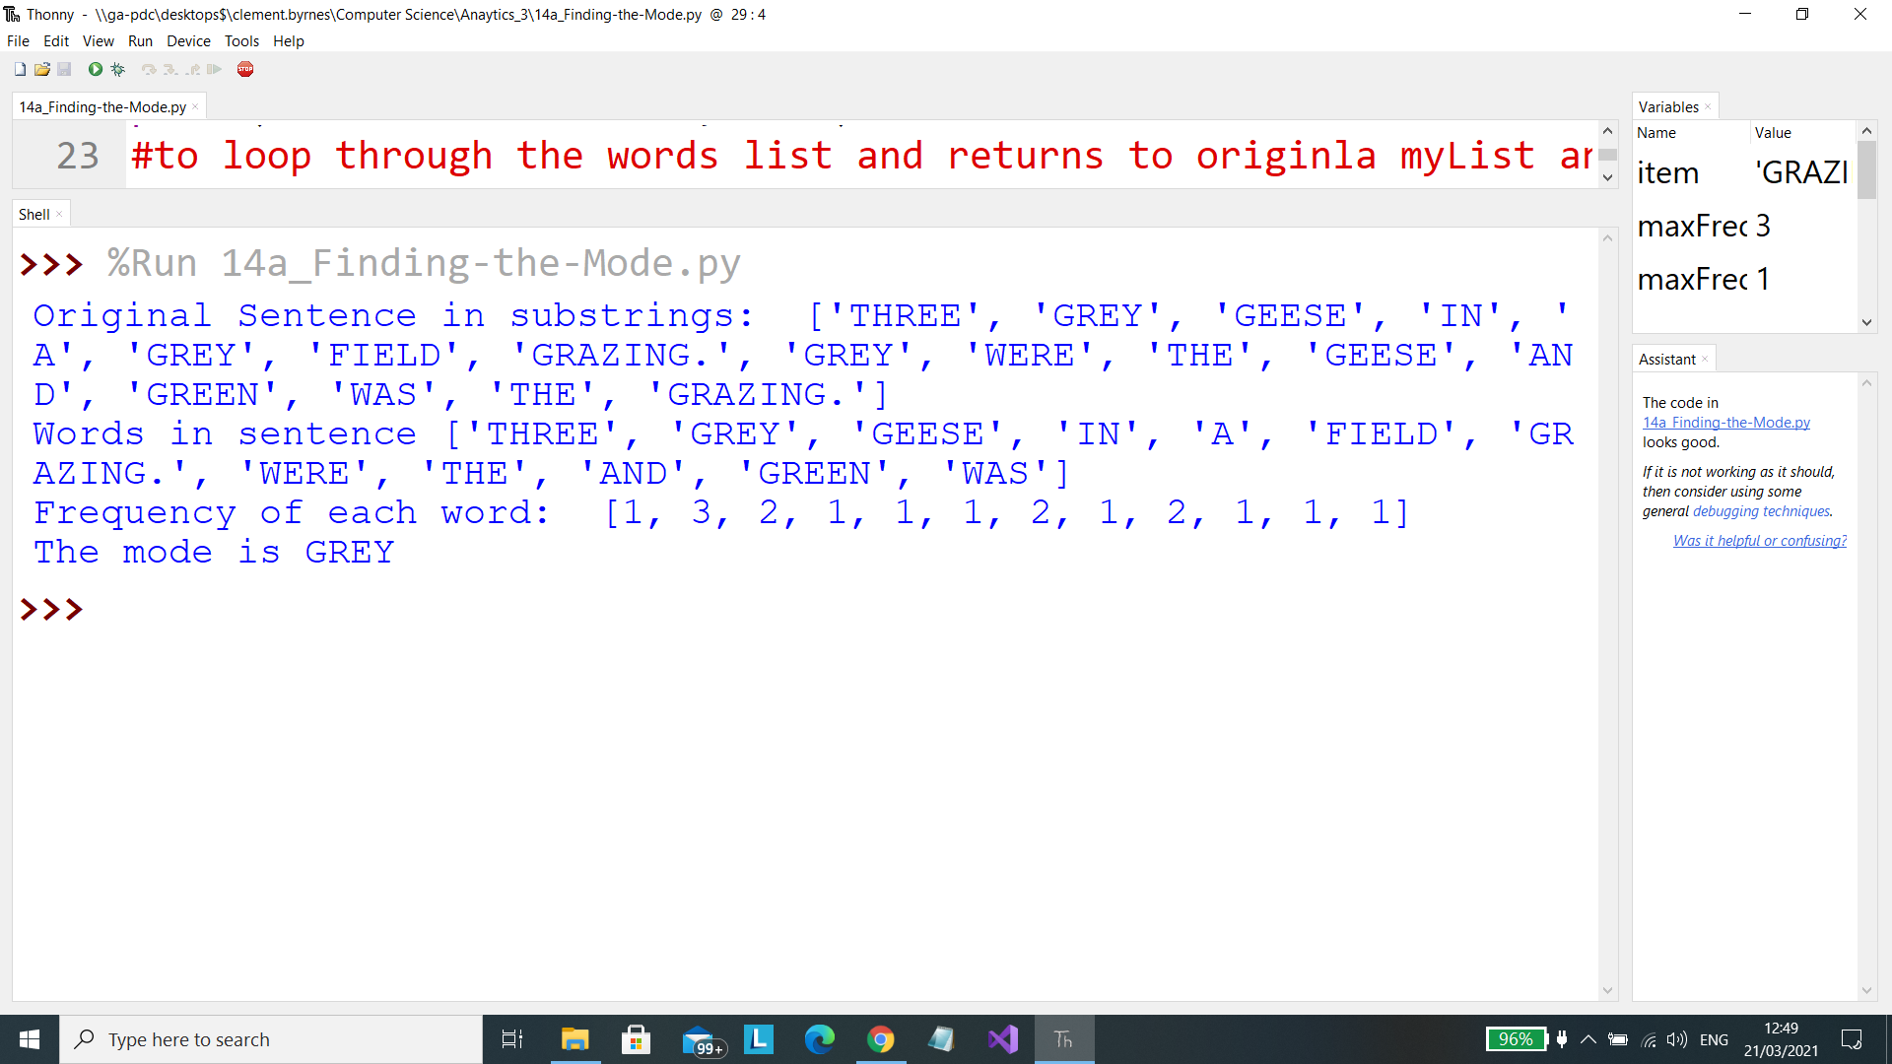
Analytics 3 (d): The Mode 1 of 2, Manually calculating the mode
This lines have been added to the previous code used to find the the frequency to find the mode.
Output

Slide 59
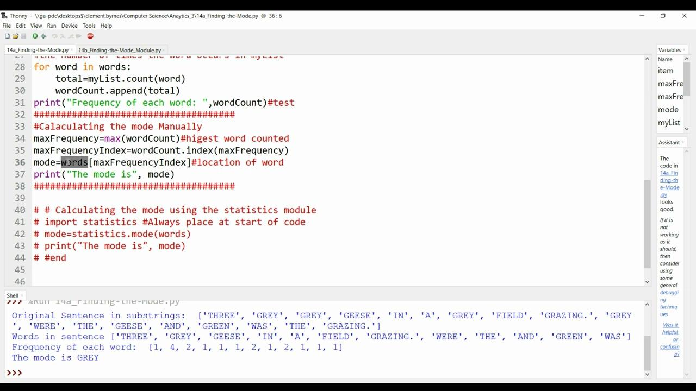
Video on code to find the mode manually of a data set

Slide 60
Analytics 3 (d) The Mode 1 of 2, Manually calculating the mode, Some questions
How we know the program is working? (i.e. actual result vs. expected result)
Change the values in the list and see what happens?
What happens if there were more (or less) than 6 values in the list?
Change the variable names as see what happens
Does this program work for a list of strings (e.g. ["Mary", "Andy", "Pat"])? Why/why not?

Slide 61
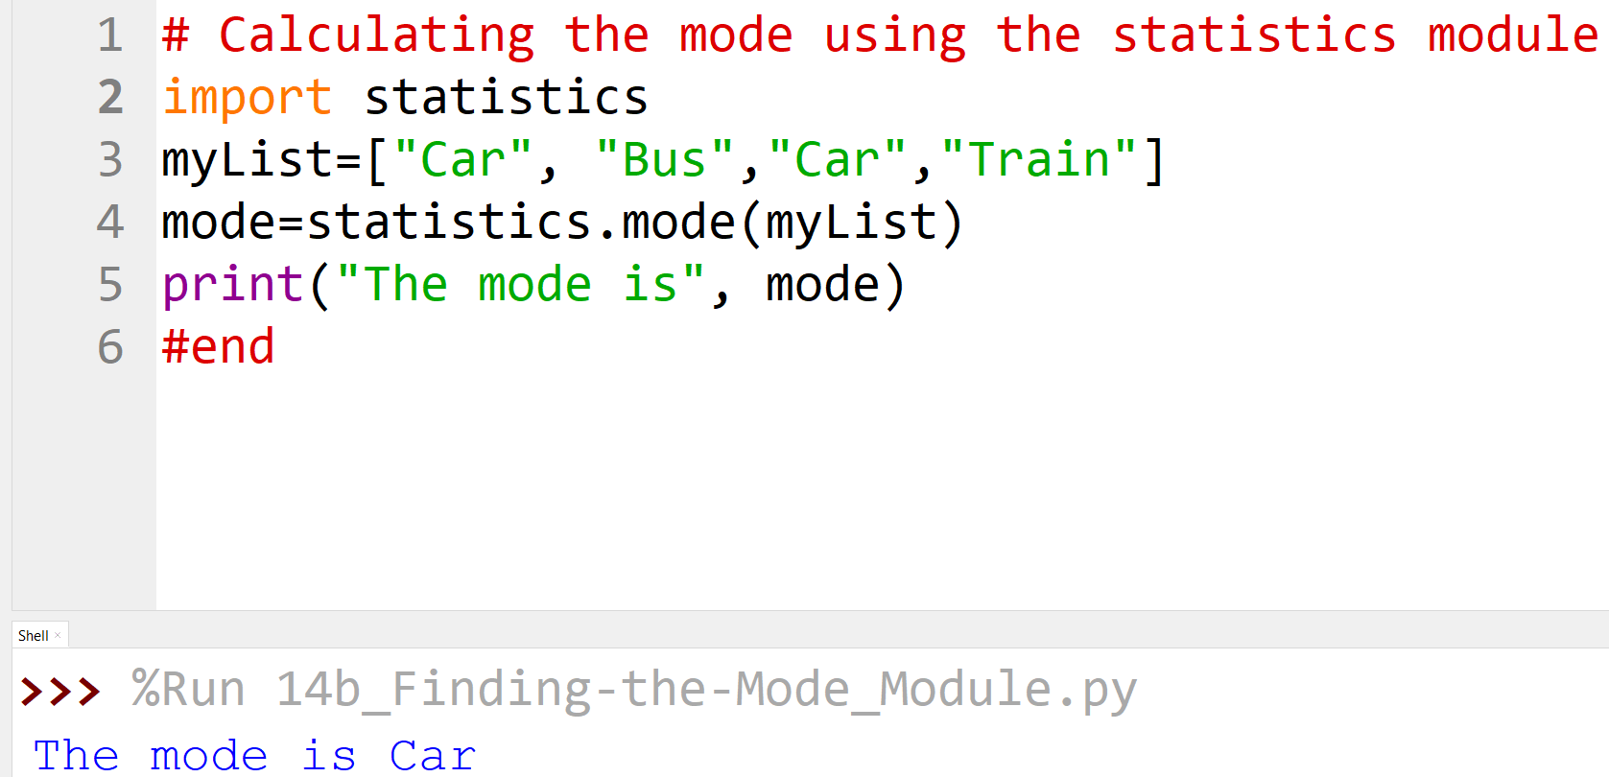

Analytics 3 (c): The Mode 2 of 2, Using statistics module
Import statistics module
Calculate the mode.
Warning:

Slide 62
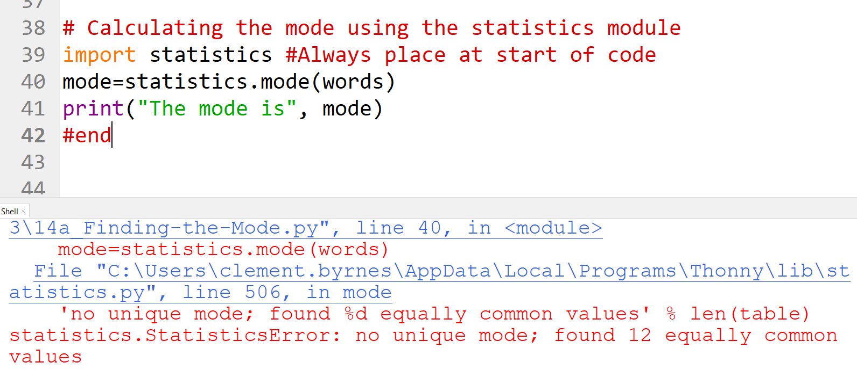
Warning when using statistics Module
Warning: When using the statistics module and two or more items have the same mode value or the list is empty, you will get an error

Slide 63
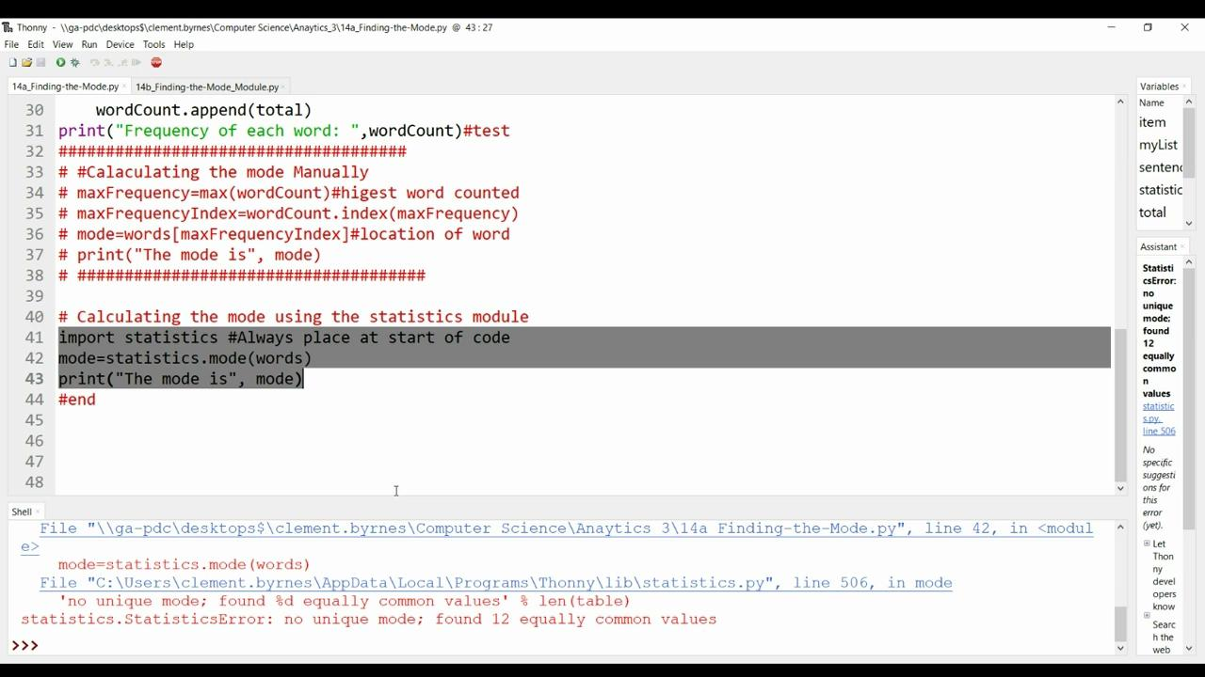
Video on code to find the mode of a data set using the statistics module

Slide 64
Computational Thinking_ before you go to the next slide
Create an Algorithm to find the mode of the following data.
1,2,3,4,5,6,3,5,7,1,1,4,6,8
Put data into list
Create two lists to store count /frequency of number occurring and value being counted
Iterate through the list counting items
Append count to list
Identify the position of the number with the highest frequency
Print modal value

Slide 65
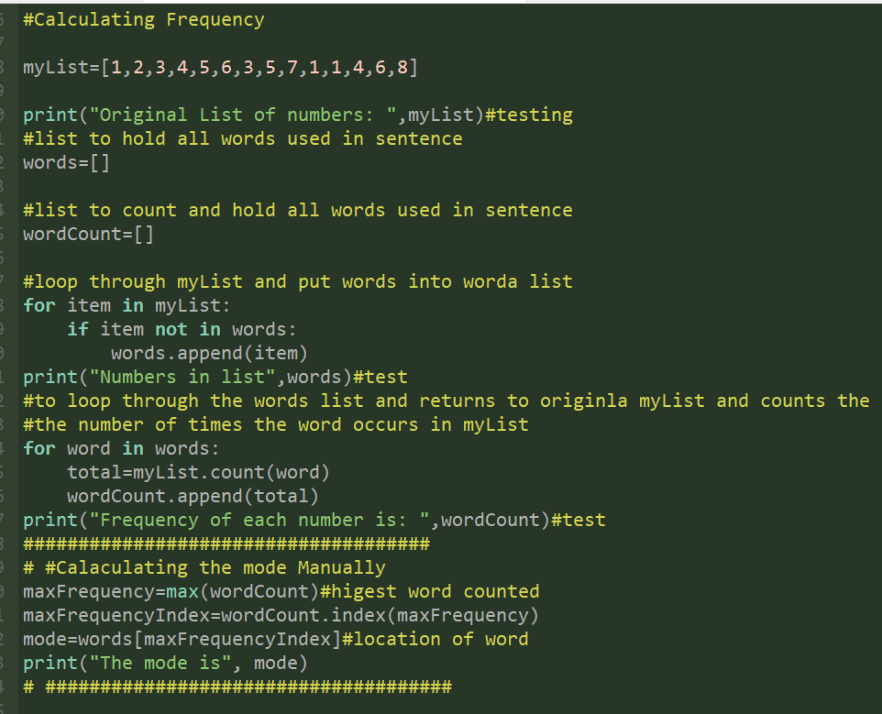
Code with algorithm to find mode of data
Code in classroom to download

Slide 66
Analytics 3 (c) :The Mode: Challenge
Write code to find the mode of the following values
1,3,6,5,7,8,7,10,3,5,3
Write an app to calculate the mode of numbers entered by a user and and print the mean of the values to the screen
Create a .csv file that contains the following values
33,44,777,88,22,2,4,2,2,6,6,88,99,1
Write code will read the values and print the mode of the values to the screen.

Slide 67
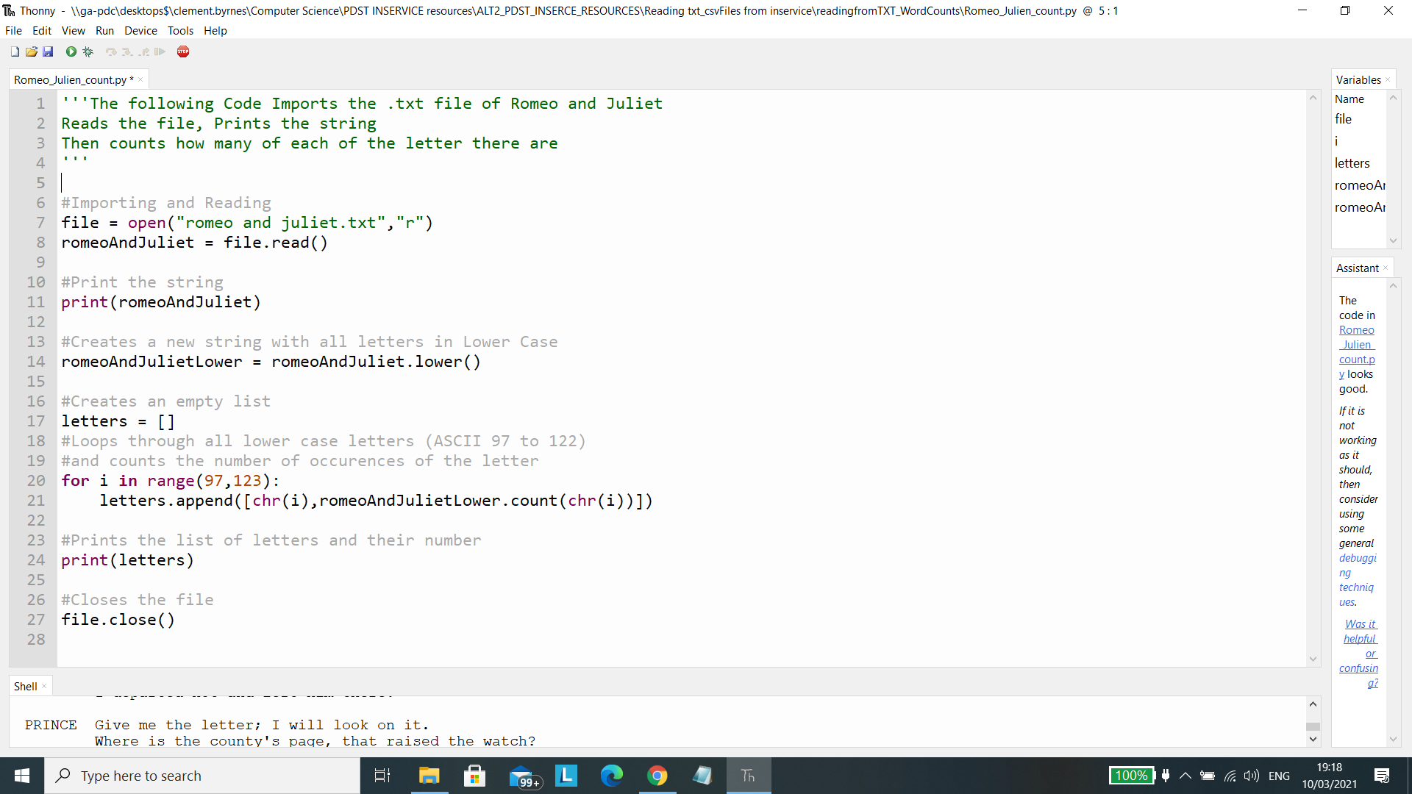
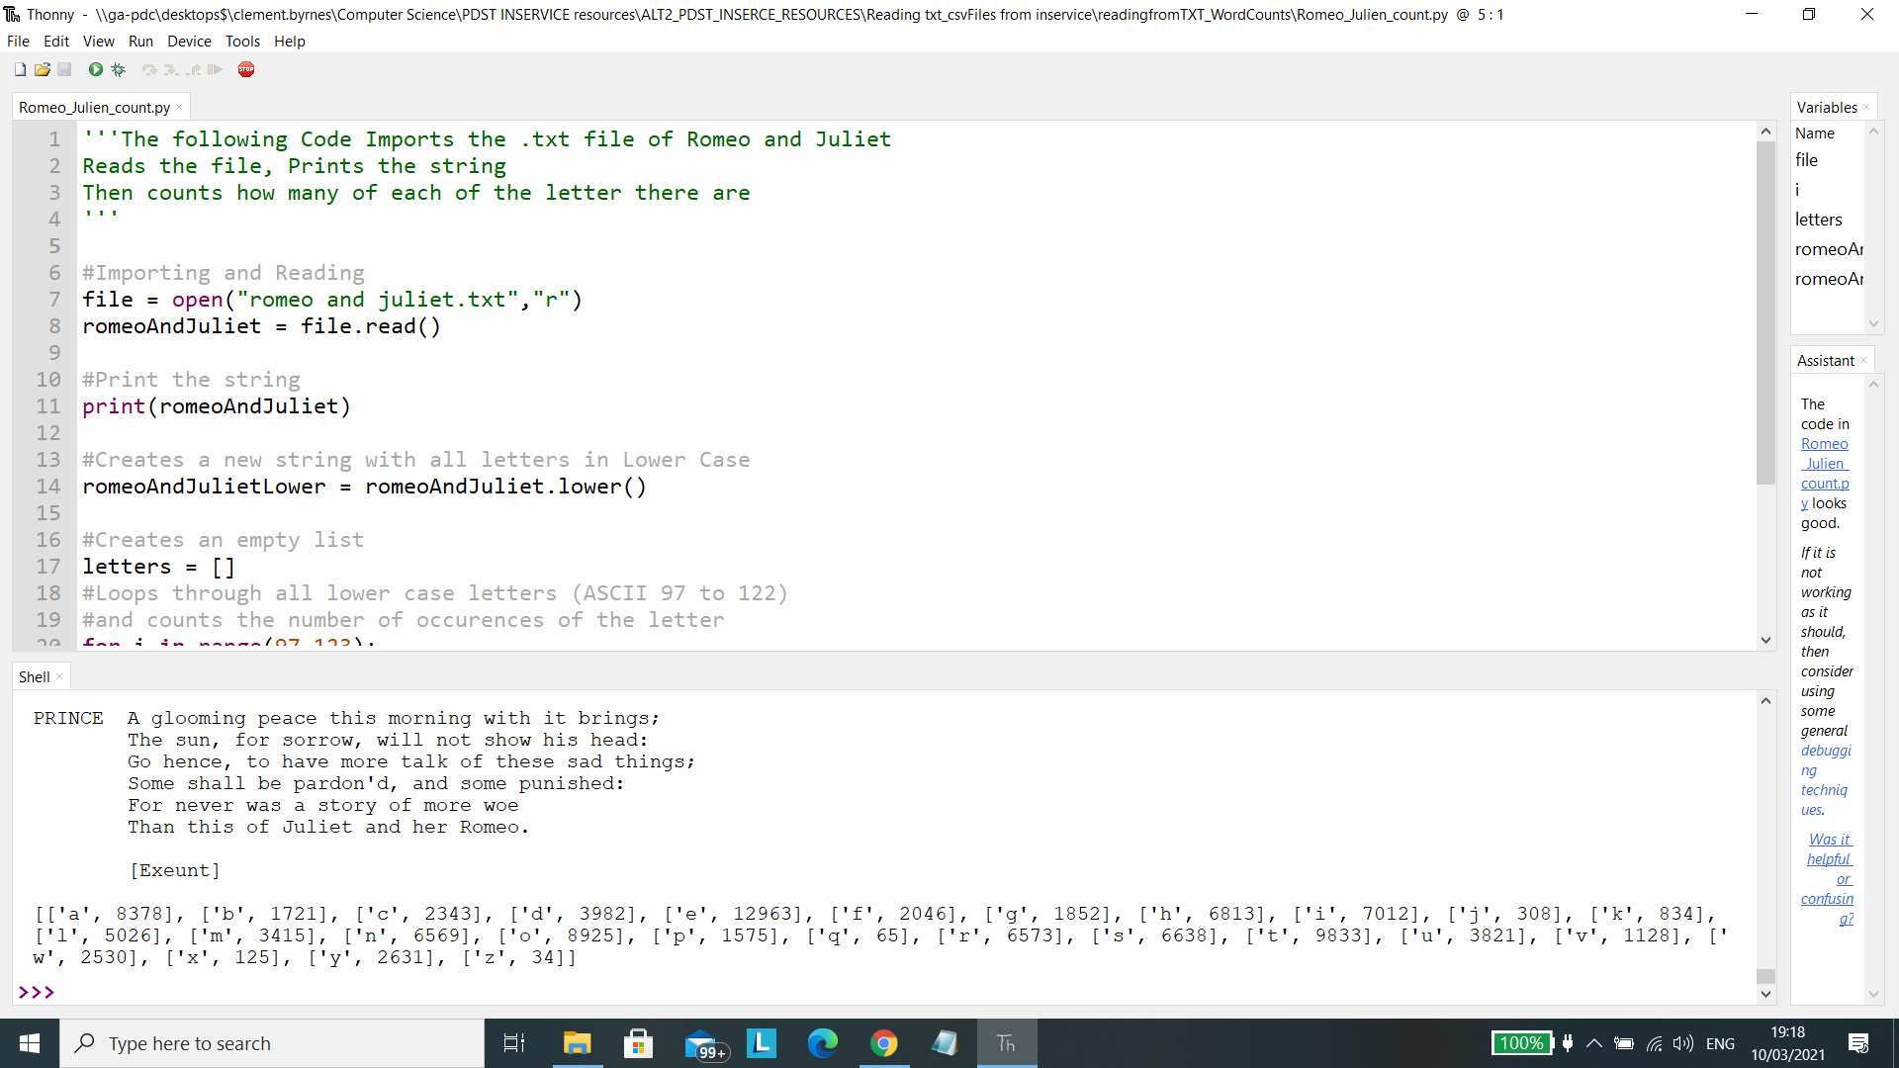
Text Analysis
Counting the number of letters are in a text
Output

Slide 68
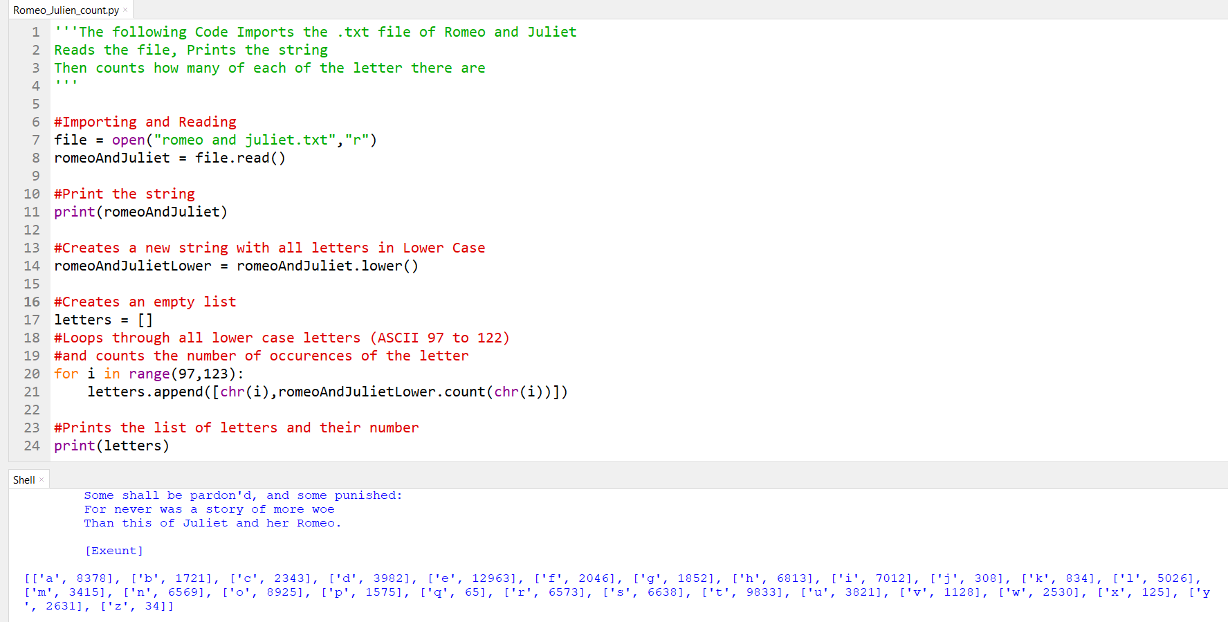
Text Analysis: Example 1
Counting the number of letters that are are in a text
Output

Slide 69
Example 2:Video on finding frequency of letters

Slide 70
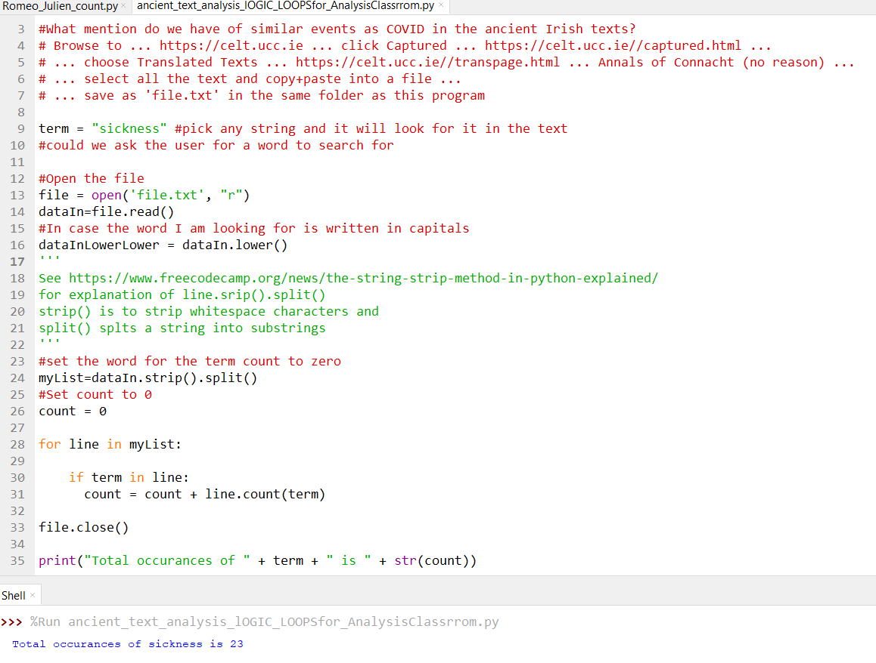
Text Analysis: Example 2
Counting the number of letters that are are in a text
Output

Slide 71
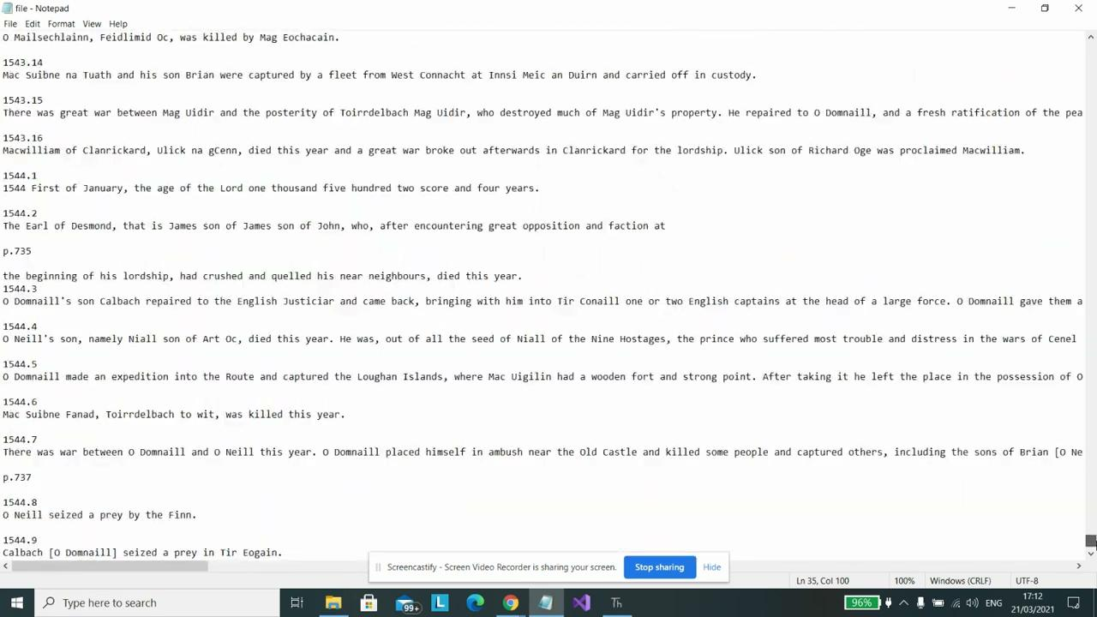
Example 2: Video on finding frequency of letters in Ancient text

Slide 72
